Slide 1
Benjamin A. Gilman International Scholarship Program
Program Overview, Eligibility, Application
The Benjamin A. Gilman International Scholarship Program is a program of the U.S. Department of State with funding provided by the U.S. Government and supported in its implementation by the Institute of International Education (IIE).

Slide 2
The Gilman Program is a program of the U.S. Department of State, Bureau of Educational and Cultural Affairs (ECA)
ECA’s mission is to increase mutual understanding between the people of the United States and the people of other countries by means of educational and cultural exchange that assist in the development of peaceful relations.
Notes:
The Gilman Scholarship is sponsored by the Bureau of Educational & Cultural Affairs, or ECA, in the U.S. Department of State.
ECA leads a wide range of academic, professional, and cultural exchanges with the goal of increasing mutual understanding and respect between the people of the United States and the people of other countries.
And the Gilman Scholarship is just one of the many programs sponsored by the ECA, and Gilman Scholars become a part of a network of approximately 55,000 people who participate in ECA programs every year.
Gilman is within the Office of U.S.A. Study Abroad, which is committed to shaping and sustaining a more peaceful, prosperous and just world by increasing and diversifying participation in study abroad. Please visit their websites for more information.

Slide 3
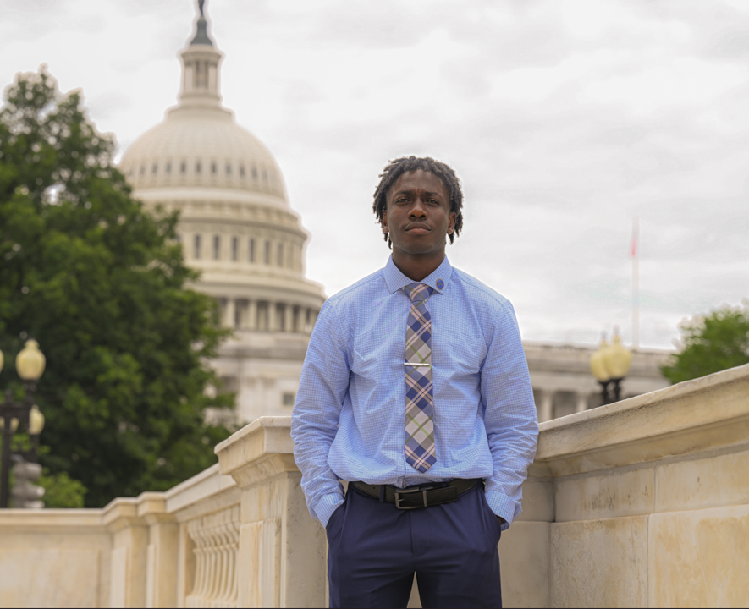
Gilman Program Highlights
All Gilman Scholars are Pell Grant recipients
50% are first-generation college students
60% come from small towns or rural communities
Over 40,000 stellar Gilman alumni
Over 160 countries of study
Over 1,300 U.S. colleges and universities represented

Slide 4
Gilman Program Info &
Eligibility
The Benjamin A. Gilman International Scholarship Program is a program of the U.S. Department of State with funding provided by the U.S. Government and supported in its implementation by the Institute of International Education (IIE).

Slide 5
Eligibility
U.S. citizen or national
Undergraduate student
Federal Pell Grant recipient
Program abroad must be credit-bearing
Program abroad must be in a country or area with an overall Travel Advisory Level 1 or 2
NO minimum program length!
Notes:
To be eligible for a Gilman Scholarship, an applicant must be:
A US citizen or national
An undergraduate student in good standing
Receiving a Federal Pell Grant during the time of application or provide proof that they will be receiving a Pell Grant during the term of their study abroad program or internship;
Applying for credit-bearing study abroad programs in a country or area with an overall Travel Advisory Level 1 or 2.
In the process of applying to, or accepted for, a study abroad or internship program eligible for credit from the student’s home institution. Multi-country/area programs are allowed. Proof of program acceptance is required prior to award disbursement
The Gilman Program no longer has a minimum program length requirement
Gilman Scholarship recipients can only receive the scholarship once. If a student previously declined the Gilman Scholarship, they are welcome to re-apply, as long as they still meet all eligibility requirements as listed above.

Slide 6
Gilman-McCain Scholarship
Recipients receive a flat $5,000 scholarship to study or intern abroad.
Eligibility requirements:
Must be a child or spousal dependents of active or activated service members.
Military personnel must be active or activated during the time of application
(Including Air Force, Air Force Reserve, Air National Guard, Army, Army National Guard, Army Reserve, Coast Guard, Coast Guard Reserve, Marine Corps, Marine Corps Reserve, Navy, Navy Reserve, Space Force)
Notes:
The U.S. Department of State’s Gilman-McCain Scholarship provides awards of $5,000 for dependents (child or spouse) of active or activated United States military personnel during the time of application to study or intern abroad on credit-bearing programs. Developed under the framework of the State Department’s Benjamin A. Gilman International Scholarship Program, the John McCain International Scholarship for Military Families (Gilman-McCain Scholarship) is open to eligible students enrolled at accredited U.S. colleges and universities who receive any type of Title IV federal financial aid.
To apply, you will use the online Gilman-McCain application and you will be required to upload a copy of your military dependent ID to submit the application.
Besides being a dependent (child or spouse) of active or activated United States military personnel during the time of application and having any type of Title IV federal financial aid, all other eligibility requirements are the same as the Gilman Scholarship.
For more information, please visit the Gilman-McCain Scholarship web page. https://www.gilmanscholarship.org/program/gilman-mccain-scholarships/

Slide 7
Gilman-McCain Eligibility Continued:
U.S. citizen or national
Undergraduate student
Program abroad must be credit-bearing
Country or area of study must be a Level 1 or 2 Travel Advisory
Recipient of any type of Title IV federal financial aid
NO minimum program length!
Recipients receive all Gilman alumni benefits
Notes:
The U.S. Department of State’s Gilman-McCain Scholarship provides awards of $5,000 for dependents (child or spouse) of active or activated United States military personnel during the time of application to study or intern abroad on credit-bearing programs. Developed under the framework of the State Department’s Benjamin A. Gilman International Scholarship Program, the John McCain International Scholarship for Military Families (Gilman-McCain Scholarship) is open to eligible students enrolled at accredited U.S. colleges and universities who receive any type of Title IV federal financial aid.
To apply, you will use the online Gilman-McCain application and you will be required to upload a copy of your military dependent ID to submit the application.
Besides being a dependent (child or spouse) of active or activated United States military personnel during the time of application and having any type of Title IV federal financial aid, all other eligibility requirements are the same as the Gilman Scholarship.
For more information, please visit the Gilman-McCain Scholarship web page. https://www.gilmanscholarship.org/program/gilman-mccain-scholarships/

Slide 8
Scholarships up to $5,000 for any term abroad
Fall
Spring
Summer
Winter or J-term
Academic Year
Notes:
For the entire academic year, we will award over many scholarships including awards for the Gilman-McCain Scholarship and awards associated with our global partnerships – the new Gilman-Taiwan Scholarship, the Gilman- Germany DAAD Scholarship, the Gilman-FLAD Portugal Scholarship, the Gilman-Global Wales Scholarship, Gilman-Education New Zealand Scholarship, and Gilman-France Scholarship.
Recipients can receive up to $5,000 to use towards program costs and related expenses, such as tuition and fees, room and board, books, local transportation, health insurance, international airfare. passport and visa costs. (Personal expenses such as clothing, entertainment, electronics and excursions outside of the program are not eligible.)
Award amounts will vary depending on student need, strength of the application, and program cost.
Students can apply the scholarship toward a fall, spring, summer, winter, or academic year term program.
The Gilman Program is often asked by students, “what are the chances of me receiving a scholarship?” Generally 1 in 4 students are awarded a scholarship.
If selected for a Gilman Scholarship, recipients will utilize the password protected and secure Gilman Recipient Portal to input all fund distribution information. Recipients of the Gilman Scholarship will never be contacted by phone or email to provide personal bank information.

Slide 9
Critical Need Language Award
Up to an additional $3,000 + access to proficiency testing
Arabic
Azerbaijani
Bahasa Indonesian
Bangla
Chinese (Mandarin)
Hebrew
Hindi
Japanese
Korean
Persian
Portuguese
Punjabi
Russian
Swahili
Turkish
Urdu
Studying these languages in sign language is also eligible
Requires an extra essay to be considered
Notes:
Applicants who are studying a critical need language in a country in which the language is predominantly spoken can apply for a supplemental award of up to $3,000. This Critical Need Language Award (CNLA) slide has list of current critical languages, but please check website as “The number of eligible countries and languages supported by the CNLA are subject to change based on U.S. Department of State Travel Advisories and priorities.]
In addition to receiving additional funds for language study, students who win this award and complete their Gilman Scholarship requirements will be offered the opportunity to take the ACTFL Oral Proficiency Interview (OPI). This test and the results will serve as both an evaluation measure of the award and as a credential for the award recipient.

Slide 10
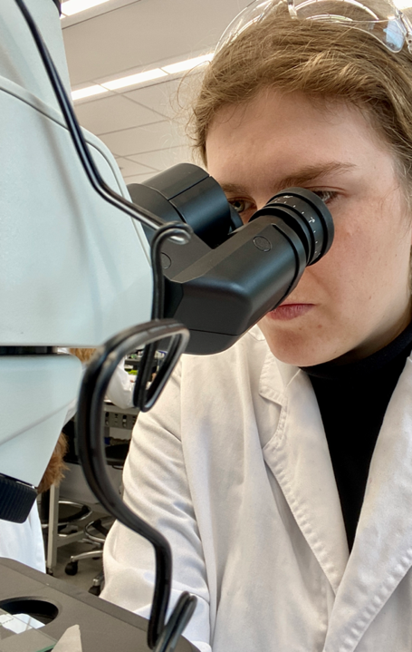
STEM Supplemental Award
Up to an additional $1,000 toward STEM research costs
In support of the Chips and Science Act of 2022
Allowable expenses may include, but are not limited to:
Lab Fees
Equipment or gear required to contact research
Fees required to conduct research, such as internet, cell phone, or printing costs
Local transportation required to conduct research
Requires an extra essay to be considered
Notes:
In support of the CHIPS and Science Act of 2022, the U.S. Department of State is dedicated to supporting students who are focused on Science, Technology, Engineering, or Mathematics (STEM) fields (defined as agriculture, engineering, health professions, math and computer science, and physical and life sciences) during their higher education. Applicants who are conducting STEM-related research as part of their study abroad or international internship program can apply for a supplemental award of up to $1,000. The research must already be formally integrated into their credit-bearing program. A successful applicant should demonstrate (in an essay of no more than 1,000 characters) a strong motivation to their STEM field(s) and how this research experience extends beyond their time abroad, and into their future academic and career goals. Of note, the applicant is not required to major in a STEM field.

Slide 11
Gilman Alumni Benefits
Join a network of over 40,000 stellar Gilman alumni
Non-competitive eligibility for federal jobs
Access to the Gilman Scholar Network
Opportunity to be an Alumni Ambassador
Opportunities to attend special events, overseas/domestic seminars & workshops
Opportunity to apply for the Gilman Alumni Changemaker Grant
Notes:
When you become a Gilman Scholar and have completed your Follow-on Service Project within 6 months after you return home, you get to have access to many different benefits and opportunities.
Non-Competitive Eligibility (NCE)
Alumni of the Gilman program are eligible for 12 months of noncompetitive eligibility (NCE) hiring status with the federal government. It allows U.S. federal government agencies to hire eligible exchange program alumni outside the formal competitive job announcement process. Gilman alumni can also compete for certain federal employment jobs that are open only to federal employees. It’s a benefit that basically allows Gilman Alumni to jump to the front of the applicant line when applying for certain federal jobs. It doesn’t guarantee them a job but makes it much easier to be hired.
This 12-month period begins on the last day of the study or intern abroad program. Federal agencies may extend the period of eligibility for as many as two additional years, or a total duration of up to three years, if after your completed program, you:
Served in the military
Studied at a recognized institution of higher education*
Were involved in another activity that, in the agency’s view, warrants an extension.
*This means that alumni who return to their undergraduate studies after completing their Gilman Program are eligible for an extension in NCE status.
Gilman Scholar Network
The Gilman Scholar Network is the official site for Gilman Scholars and Alumni to connect with one another via a secure and private platform. The Gilman Scholar Network also gives Gilman Scholars and Alumni access to exclusive job postings and Gilman events.
Gilman Alumni Ambassador Program They serve for one year as official representatives of the U.S. Department of State’s Gilman International Scholarship Program. They provide testimonials about their Gilman Scholarship experiences at campus presentations and offer application tips via written articles, videos, webinars, and special events.
Seminars & Career Workshops
These events are available to all Gilman Scholars and Alumni to network and connect with other alumni. These workshops are also a great place to learn about the many career opportunities.
Gilman Alumni Changemaker Grant
Funded by IIE’s Board of Trustees, The Gilman Alumni Changemaker Grant enables Gilman alumni to continue to give back to communities through grant-supported projects. Visit gilmanscholarship.org to learn more

Slide 12
Application
The Benjamin A. Gilman International Scholarship Program is a program of the U.S. Department of State with funding provided by the U.S. Government and supported in its implementation by the Institute of International Education (IIE).

Slide 13
2 Steps
Student Application
Advisor Certification
1
2
Abroad Program Info
Essays
Unofficial Transcript(s)
Select Advisors
Study Abroad Advisor
Financial Aid Advisor
Notes:
The entire application process is conducted online and has two steps.
Step 1: The online application asks for study abroad/internship program details, three essays (or additional 4th essay if you’re applying for the CNLA), and an undergraduate transcript. The Gilman Program requires transcripts for applicants’ current institution and transcripts from any previous institutions attended. ​These transcripts can be official or unofficial. I’ll talk about the essays in the next slides.
The application also requires applicants to select a study abroad advisor and a financial aid advisor within the application.
Step 2: Once the student has submitted the application, it must be certified by both a study abroad and financial aid advisor. The deadline the advisor certifications is one week after the students’ deadline.

Slide 14
Essay #1
Required Max. 7000 Characters
Statement of Purpose
Personal Interview
You + Program + Goals
Meeting Challenges
(academic, professional, personal)
Notes:
There are two community impact essays that are both required and are equally important. We strongly encourage you to read the Selection Criterion Community Impact Abroad & Student’s Return Home.
The Community Impact: Building Mutual Understanding Essay requires you to answer how you will be a U.S. citizen diplomat as a Gilman Scholar while abroad
​
Key aspects to this essay are how you will be a U.S. representative abroad and how you will seek opportunities to become more culturally engaged and have meaningful interactions with people from different cultures on your abroad program.
This essay has a maximum of 3,000 characters.

Slide 15
5 Questions to ask yourself
Statement of Purpose Essay
How will studying or interning abroad help you achieve your future academic or professional goals?
Why did you select your specific program and host country?
How are you academically prepared to be a successful scholar abroad? Disclose any significant academic difficulties you have faced.
What examples of knowledge, skills, and experiences will you draw on to navigate a different environment abroad?
Notes:
Here are some questions to reflect on while writing your statement of purpose.
How will studying or interning abroad help you achieve your future academic or professional goals?
Why did you select your specific program and host country?
How are you academically prepared to be a successful scholar abroad? Disclose any significant academic difficulties you have faced.
What examples of knowledge, skills, and experiences will you draw on to navigate a different environment abroad?

Slide 16
Essay #2
Required Max. 3000 Characters
Community Impact:
Building mutual understandings essay
What it means to be a U.S. Citizen while abroad
How you will seek opportunities to be culturally engaged
Seeking opportunities to have meaningful interactions
Notes:
There are two community impact essays that are both required and are equally important. We strongly encourage you to read the Selection Criterion Community Impact Abroad & Student’s Return Home.
Gilman Scholars represent the United States as citizen diplomats in their host communities; they reflect a broad range of values, beliefs, and opinions that is fundamental to providing a balanced representation of the United States abroad. Gilman Scholars are expected to contribute to the goal of building mutual understanding by sharing their own background and experiences as a U.S. citizen as well as learning about and building meaningful connections within the host community. .
This essay has a maximum of 3,000 characters.

Slide 17
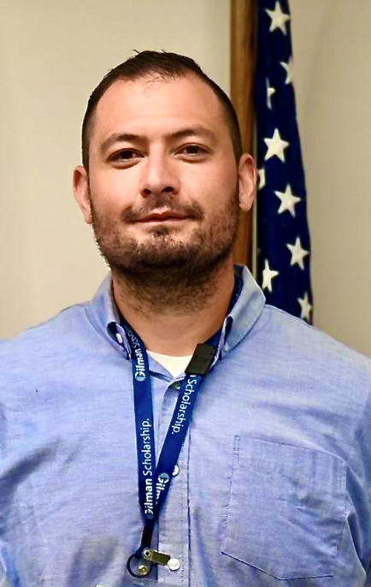
2 Questions to ask yourself
Building Mutual Understanding Essay
Thinking ahead to your experience abroad, how will you represent the United States and share your own background and experiences as a U.S. citizen during your program?
What opportunities will you seek to engage in the culture and build meaningful connections within your host community?
Notes:
Here are some questions to reflect on while you write the essay on building mutual understanding:
Thinking ahead to your experience abroad, how will you represent the United States and share your own background and experiences as a U.S. citizen during your program?
What opportunities will you seek to engage in the culture and build meaningful connections within your host community?

Slide 18
Essay #3
Required Max. 3000 Characters
Community Impact:
Follow-on Service Project Essay
Being an effective citizen diplomat while abroad
How will you give back by inspiring others to study abroad?
On campus or in home community
Design plan of action
(audience, tools, timeline)
Notes:
The Gilman Program and the program’s sponsors at the U.S. Department of State value the multiplier effect that this program has on U.S. campuses and communities.
Therefore, the Follow-On Service Project Proposal requires you to answer how you will represent the Gilman Program upon your return home by requiring you to design a project to promote the Gilman Scholarship Program. In this essay, students are asked to map out a potential project for them to complete upon their return to the U.S. that will encourage others to study or intern abroad and spread awareness of the Gilman Scholarship Program.
The project can be completed on their home campus or in their local community and must be completed within 6 months of their return to the U.S. Key aspects of this essay include how you will be an effective U.S. representative at home and the creativity and feasibility of your Follow On Service Project.
The Gilman Program advises students to use activities and organizations that they are already involved in as an inspiration and can therefore begin discussion of their project with key contacts even prior to being awarded the scholarship.
We also ask that students consider their audience, tools, and timeline when proposing a project in the Gilman Scholarship Program application.
This essay has a maximum of 3,000 characters.

Slide 19
3 Questions to ask yourself
Follow-On Service Project Proposal
What is your project and how will it increase awareness of study abroad and the Gilman Program among your peers in your home or campus community?
How will you integrate the impact of your experience abroad into your project?
With which campus departments, student organizations, or community organizations will you collaborate?
Notes:
Here are some questions to reflect on while writing your Follow-on Service Project Proposal:
What is your project and how will it increase awareness of study abroad and the Gilman Program among your peers in your home or campus community?
How will you integrate the impact of your experience abroad into your project?
With which campus departments, student organizations, or community organizations will you collaborate?

Slide 20
Essay #4
Optional Max. 2000 Characters
Critical Need Language Award Essay
Is it predominantly spoken in the country you’re going to?
How does it relate to your academic or career goals?
Motivations for improving language proficiency
Is it a critical need language?
(academic, professional, personal)
Notes:
As explained earlier, applicants who are studying a critical need language while abroad in a country in which the language is predominately spoken have the option to be considered for the Critical Need Language Award, for a supplemental award of up of $3,000. This award is competitive and offered to a limited number of students each year. To be considered for the Critical Need Language Award, a brief additional essay is required and can be submitted in the same Gilman application.
Some key points to keep in mind are:​
Be sure that the language you are studying while abroad is considered a Critical Need Language by the U.S. Department of State. You can see the list of Critical Need Languages at gilmanscholarship.org. Any other language study is not eligible for the Critical Need Language Award.​
Be sure that you are studying the Critical Need Language in a country where it is predominately spoken. ​
Explain the level of intensity of your critical need language study while abroad, how studying this language will further your academic and career goals, what your motivations are for learning or improving your language proficiency, and how you intend to improve your language skills while studying abroad.
This essay has a maximum of 2,000 characters.

Slide 21
Essay #5
Optional Max. 1000 Characters
STEM Supplemental Award Essay
Are you conducting STEM research?
Is the STEM research a formalized part of your abroad program?
How does it relate to your academic or career goals?
Motivations for STEM research/field
(academic, professional, personal)
Notes:
As explained earlier, applicants who are conducting STEM-related research as part of their study abroad or international internship program can apply for a supplemental award of up to $1,000.
Keep in mind that applicants will be asked the following:
summarize your STEM-related research component and your overall motivation toward this STEM field.
also share how this will contribute to your future academic and/or career goals.
This essay has a maximum of 1,000 characters.

Slide 22
Selection Criteria
Impact of Program & Destination on Student’s Academic & Career Directory
Community Impact Abroad & Upon Student’s Return Home
Academic Preparedness
Commitment to Proficiency in a
Critical Need Language or STEM Research
Notes:
Impact of program & destination on student’s academic & career trajectory:
The U.S. Department of State’s Benjamin A. Gilman International Scholarship Program (Gilman Program) supports outstanding American undergraduate students of limited financial means from a broad range of backgrounds to pursue study or internships abroad, during which they gain skills that promote individual growth, contribute to career readiness, serve as citizen ambassadors, and support American economic competitiveness and national security. A successful Gilman applicant will describe how a specific program and destination will enable the applicant to reach their academic and/or career goals. A successful applicant will also clearly articulate what they anticipate gaining academically and professionally from their experience abroad.
Note: Preference will be given to applicants who have not studied abroad before and to Veterans of the U.S. Armed Forces.
Community Impact Abroad & Upon Student’s Return Home
The mission of the U.S. Department of State’s Bureau of Educational and Cultural Affairs is to increase mutual understanding between the people of the United States and the people of other countries by means of educational and cultural exchange. The Gilman Program plays an essential role in achieving this mission as study abroad is a form of citizen diplomacy through educational exchange. Gilman Scholars represent the United States as citizen ambassadors in their host communities, reflecting a balanced representation of the United States abroad. A successful Gilman applicant will articulate how he or she anticipates contributing to the goal of building mutual understanding by sharing his or her own background and experiences as a U.S. citizen, as well as learning about and building meaningful connections within the host community.
Upon return to the United States, Gilman Scholars inspire the next wave of students to study or intern abroad through the required Follow-on Service Project. The goal of the Follow-on Service Project is for Gilman Scholars to increase awareness of study abroad and the Gilman Program among their peers in their home communities and campuses. A successful Gilman applicant will design a Follow-on Service Project proposal that is feasible, utilizes one’s experience abroad, and connects to various groups of Americans studying at a broad range of U.S. higher education institutions.
Academic Preparedness (Updated)
The U.S. Department of State is committed to ensuring that Gilman Scholars are successful on their programs abroad. A successful Gilman applicant must demonstrate the academic preparedness needed to benefit from a study abroad or international internship program. They should disclose any significant challenges they have faced in their academic career and discuss how they will be academically successful on their study or intern abroad program. Academic performance, particularly in the applicant’s major, is important, though there is no minimum grade point average required for selection as a Gilman recipient.
Additional Review Criteria For Students Applying for the Critical Need Language Award:
The supplemental essay completed by students applying for the Critical Need Language Award will be considered using the following additional criteria: The U.S. Department of State is dedicated to supporting students who are studying a critical need language (those deemed important to national security). Applicants are considered for this category if while abroad they are taking a course taught in a critical need language, studying a critical need language, or both, in a country or area that predominantly speaks the language. A successful applicant should demonstrate a strong motivation to achieve proficiency in the language that extends beyond their study abroad experience, and into their future academic and career goals.
Additional Review Criteria For Students Applying for the STEM Supplemental Award:
In support of the CHIPS and Science Act of 2022, the U.S. Department of State is dedicated to supporting students who are focused on Science, Technology, Engineering, or Mathematics (STEM) fields (defined as agriculture, engineering, health professions, math and computer science, and physical and life sciences) during their higher education. Applicants are considered for this category if while abroad they are conducting STEM-related research as part of their study abroad or international internship program. The research must already be formally integrated into their credit-bearing program. A successful applicant should demonstrate a strong motivation to their STEM field(s) and how this research experience extends beyond their time abroad, and into their future academic and career goals. Of note, the applicant is not required to major in a STEM field.

Slide 23
Deadlines & Timelines
The Benjamin A. Gilman International Scholarship Program is a program of the U.S. Department of State with funding provided by the U.S. Government and supported in its implementation by the Institute of International Education (IIE).

Slide 24
Application Opens
Application Deadline
Advisor Deadline
October 2024 Deadline
Mid-August
October 10, 2025, 11:59pm PT
October 18, 2024
Abroad Program Starts
Dec 2024 – Oct 2025
March 2025 Deadline
March 6, 2025
11:59pm PT
March 13,
2025
Mid-January
Abroad Program Starts
May 2025 – April 2026
Notes:
There are two deadlines to keep in mind: the applicant deadline (which is the deadline for students to have submitted their application) and the advisor deadline (which is the deadline for both advisors to have completed their certifications of the student’s application).
The application deadline is Thursday, October 10, 2024, at 11:59pm Pacific Time, and the advisor certification deadline is Friday, October 18, 2024 at 11:59pm Pacific Time. Please be aware that the application deadline is in Pacific Time and take into consideration any time difference as you prepare to submit your application.
Please note again that the deadlines are at 11:59pm Pacific Time.

Slide 25
Application Tips
& Other Resources
The Benjamin A. Gilman International Scholarship Program is a program of the U.S. Department of State with funding provided by the U.S. Government and supported in its implementation by the Institute of International Education (IIE).

Slide 26
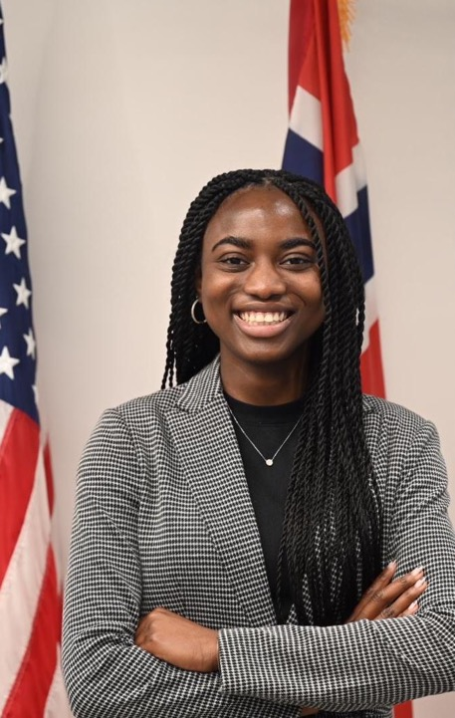
Gilman Scholar’s Tips for Applicants
“Create a compelling story that ties your past, present, and future to highlight the impact the scholarship will have on you.”
“Start the application early, be your truest self, and have confidence that you are worthy.”
Notes:
So, you’ve decided you want to study or intern abroad, you’ve determined you’re eligible for the Gilman Scholarship, but you know that it’s competitive. You might wonder what makes a strong application? –
The best tip is to begin planning early. You will need to coordinate a lot of information related to your program abroad, your academics at home, your financial and logistical resources, as well as spend time working on your essays and actually completing the application. You also have to get a hold of your transcript, which often takes a few days.
A survey of previous applicants indicated that it takes an average of five to ten hours to complete the Gilman Scholarship application, so if you begin planning early you will be sure to have a quality application in way before the last minute.
Talk with your advisors. This goes hand in hand with planning early. Talking with your advisors will ensure that you always have up to date information about your program, and that your advisors always have up to date information about your Gilman Application.
Spend quality time on your essays. Your essays are the portion of your Gilman Application that you will be able to use to fully present yourself to the Selection Panel. Because you will not meet them in person, and because the Review panel does not make any assumptions about an applicant, you must use your essays as a chance to let the panelists get to know you.
It’s important to take the opportunity in your essay to really demonstrate who you are and why you want to study/intern abroad, get across your passion and interests. A student who says they just want to go somewhere is not as compelling as a student who talks about the impact of their proposed program.
For all your essays, make sure that you fully answer the prompts, and that you invest time in writing drafts, editing, and having others proofread your essays. You wouldn’t believe how many students we have every year that write “study aboard” instead of “study abroad.” The extra steps to proofread and make corrections ensures that your essays are easy to read and the reviewers are able to get to know you.
Before you submit your application, you have the opportunity to review your application before you finally submit it. Take the time to check for accuracy regarding all information you’ve inputted. Putting the wrong information may cause your application to not meet eligibility requirements and therefore put you out of scholarship consideration.
These are all simple steps and works best when you start the process as early as possible, not waiting until the last minute to complete and submit! Every cycle we have students who have questions the night of the application deadline. Please know that we are not available at 10pm to answer last minute questions so make sure you take care of any issues before that time.
And finally, make sure that you stay updated with us and Gilman through social media, emails, phone, and other communication lines.

Slide 27
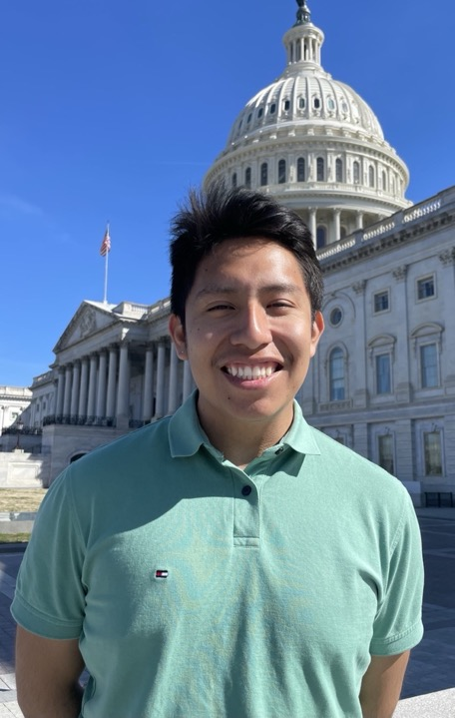
Gilman Scholar’s Tips for Applicants
“For your Follow-on Service Project, think about your community and local schools. Think of how you heard about Gilman and how you could tell others about it!”
“If you don’t apply, you’ll never get it!”
Notes:
So, you’ve decided you want to study or intern abroad, you’ve determined you’re eligible for the Gilman Scholarship, but you know that it’s competitive. You might wonder what makes a strong application? –
The best tip is to begin planning early. You will need to coordinate a lot of information related to your program abroad, your academics at home, your financial and logistical resources, as well as spend time working on your essays and actually completing the application. You also have to get a hold of your transcript, which often takes a few days.
A survey of previous applicants indicated that it takes an average of five to ten hours to complete the Gilman Scholarship application, so if you begin planning early you will be sure to have a quality application in way before the last minute.
Talk with your advisors. This goes hand in hand with planning early. Talking with your advisors will ensure that you always have up to date information about your program, and that your advisors always have up to date information about your Gilman Application.
Spend quality time on your essays. Your essays are the portion of your Gilman Application that you will be able to use to fully present yourself to the Selection Panel. Because you will not meet them in person, and because the Review panel does not make any assumptions about an applicant, you must use your essays as a chance to let the panelists get to know you.
It’s important to take the opportunity in your essay to really demonstrate who you are and why you want to study/intern abroad, get across your passion and interests. A student who says they just want to go somewhere is not as compelling as a student who talks about the impact of their proposed program.
For all your essays, make sure that you fully answer the prompts, and that you invest time in writing drafts, editing, and having others proofread your essays. You wouldn’t believe how many students we have every year that write “study aboard” instead of “study abroad.” The extra steps to proofread and make corrections ensures that your essays are easy to read and the reviewers are able to get to know you.
Before you submit your application, you have the opportunity to review your application before you finally submit it. Take the time to check for accuracy regarding all information you’ve inputted. Putting the wrong information may cause your application to not meet eligibility requirements and therefore put you out of scholarship consideration.
These are all simple steps and works best when you start the process as early as possible, not waiting until the last minute to complete and submit! Every cycle we have students who have questions the night of the application deadline. Please know that we are not available at 10pm to answer last minute questions so make sure you take care of any issues before that time.
And finally, make sure that you stay updated with us and Gilman through social media, emails, phone, and other communication lines.

Slide 28
Why Gilman?
“I’ve worked with students seeking career-development who find in the Gilman Program a viable avenue to fund their experience abroad. And I’ve seen countless Gilman recipients return from their experiences abroad as global citizens, ready to take on the challenges ahead.”

Slide 29
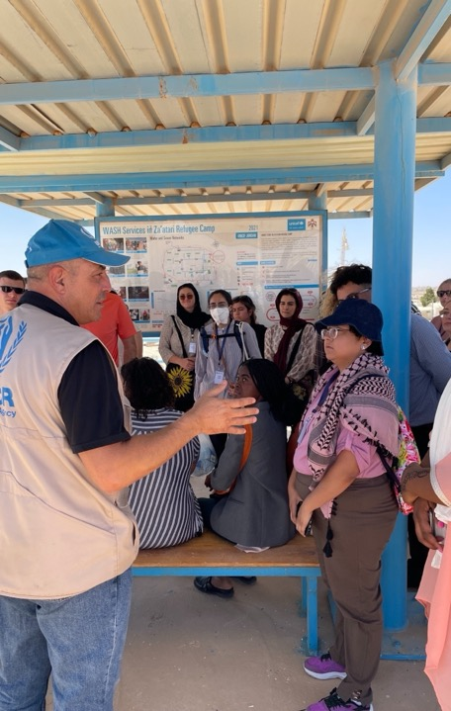
Resources for International Exchange
Other Funding Resources
Critical Language Scholarship Program
Fulbright U.S. Student Program
Boren Scholarships and Fellowships
Notes:
There are also many other resources available to you as you search for study or internship abroad scholarships.
There are resources available on the Gilman website as well as www.studyabroad.state.gov, which is an online searchable database of various study abroad scholarships. The USA Study Abroad Office website also has resources for additional opportunities including the Critical Language Scholarship, the Boren Award for International Study, Project GO, the Fulbright U.S. Student Program, and many others.

Slide 30
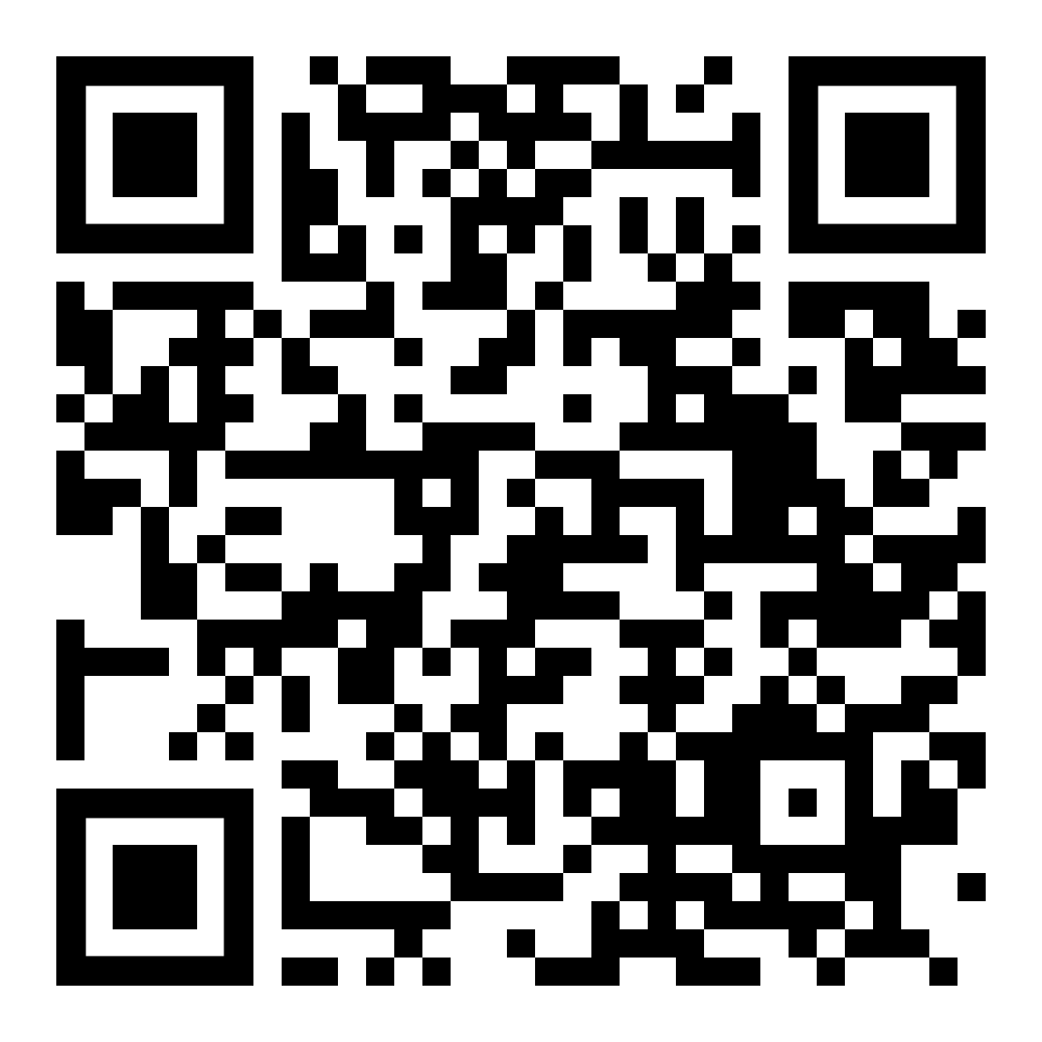
Stay Connected
Follow the Gilman Program
on Instagram and other platforms
#GilmanScholarship
X
Facebook
YouTube
Notes:
There are lots of ways to stay connected to the Gilman Program for program updates and information. The Gilman YouTube channel has videos from previous recipients, as well as instructional videos on things such as uploading transcripts and navigating the application site.
Or simply search #gilmanscholarship to see more!

Slide 31
Gilman@iie.org
800.852.2141 Ext. 1
Gilmanscholarship.org
Contact Us
Notes:
If you have any questions, you can reach out to the Gilman Scholarship Program directly.

Slide 32
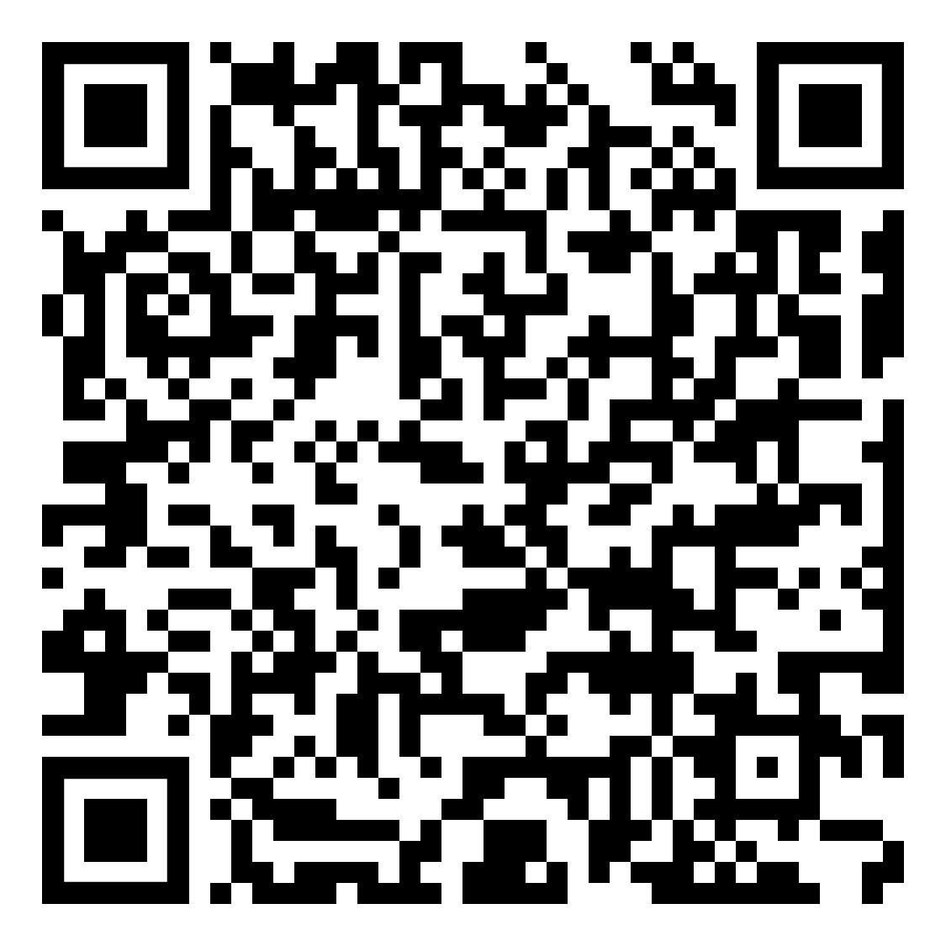
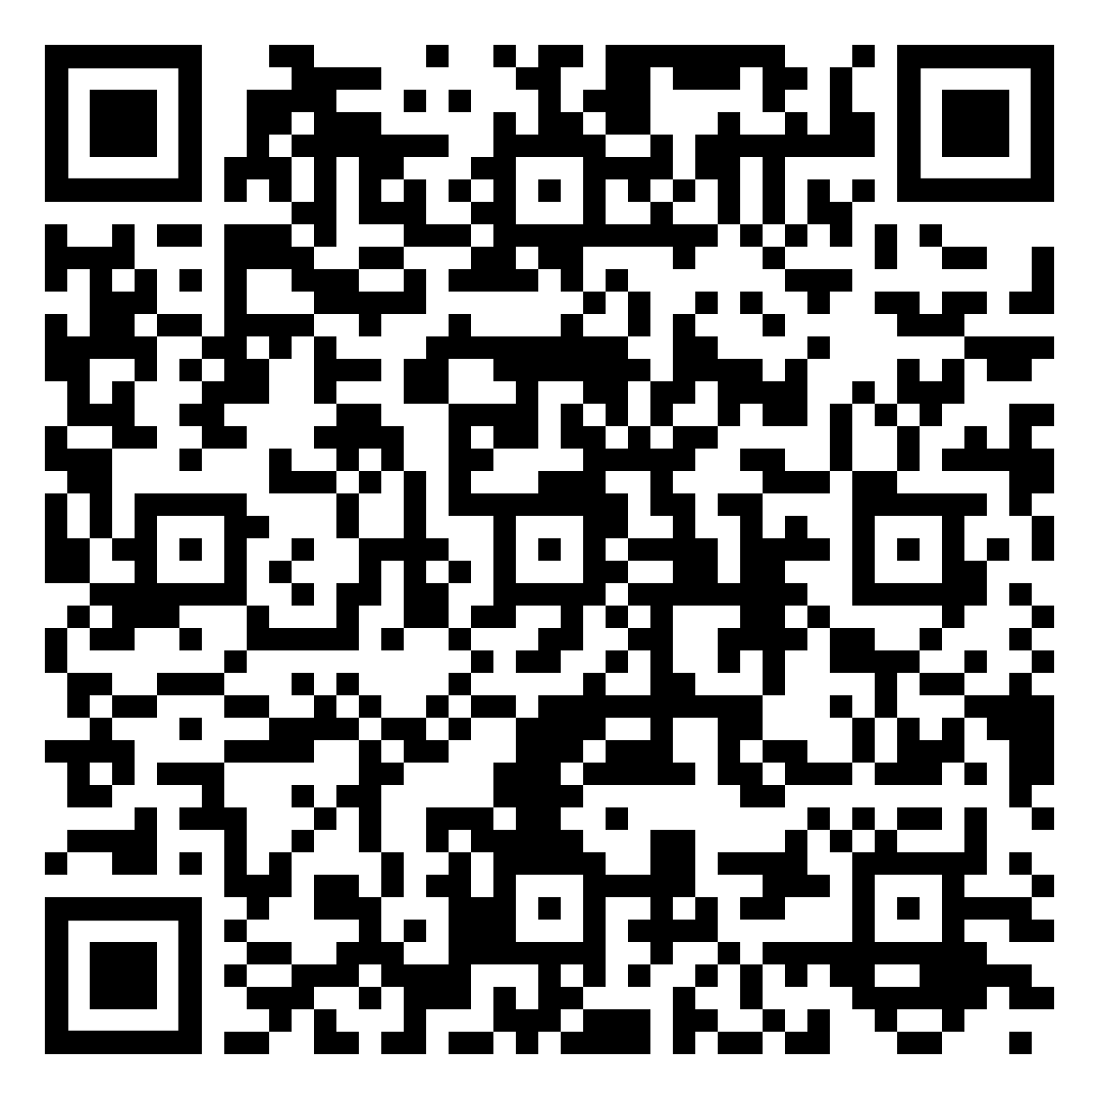
Flyers
Gilman One-Pager
Gilman-McCain One-Pager
Notes:
You can view the Gilman digital flyers here and keep them to learn more about the Gilman Program.
If you can’t use QR codes, copy and paste the following links into your browser:
Gilman One-Pager: https://www.gilmanscholarship.org/wp-content/uploads/2024/05/Gilman_TwoPager_May-2024_New.pdf
Gilman-McCain One-Pager: https://www.gilmanscholarship.org/wp-content/uploads/2023/08/GilmanMcCain_OnePager_no-dates_August-2023.pdf

Slide 33
Mesa Community College
Contact Information
Email: studyabroad@mesacc.edu
Phone: 480.461.7870
Website: mesacc.edu/study-abroad
Writing Center
Email: nicole.bradley@mesacc.edu
Phone: 480.461.7678
Website: mesacc.edu/writingcenter
Namibia Study Abroad – Himba Village

